Slide 1
HAZOP Modeling Using Machine Learning

Slide 2
HAZOP
HAZOP (Hazard and Operability Study) is a well-established method for identifying potential hazards and operability issues in industrial processes. It is a systematic and structured approach used in industries like chemical, petrochemical, and manufacturing to analyze potential risks and ensure safe operations.
While Machine Learning (ML) can be utilized in various aspects of industrial safety and risk management, its direct application to HAZOP studies is limited due to several challenges. Some of these challenges include the need for human expertise in understanding complex processes and the scarcity of large-scale labeled datasets for supervised learning in this domain.

Slide 3
Supervised OR Unsupervised ML ?
Use supervised learning when you have a labeled dataset, meaning that the input data is paired with the corresponding desired outputs (labels).
Use unsupervised learning when you have unlabeled data and want the model to find patterns or structures in the data without explicit guidance.
Supervised learning can be used for tasks like hazard prediction, risk classification, or even decision support in HAZOP studies.

Slide 4
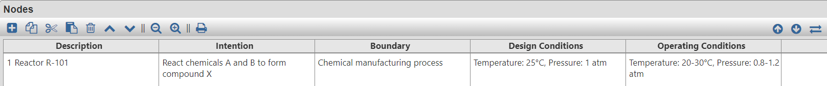
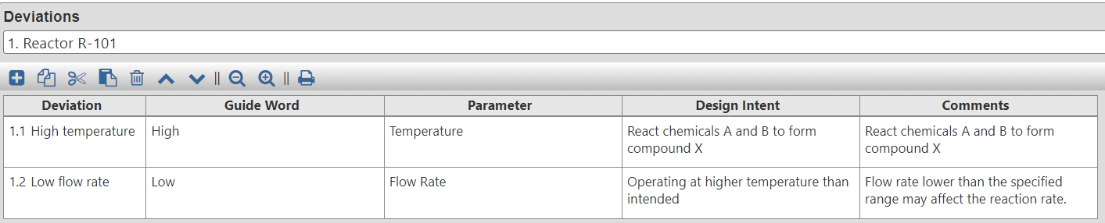
Nodes and Deviations

Slide 5
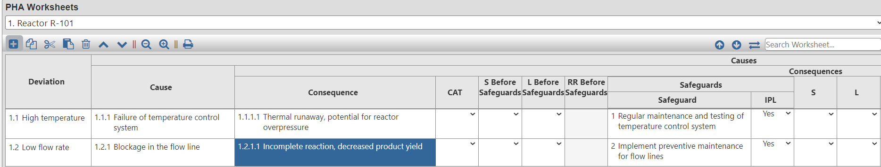
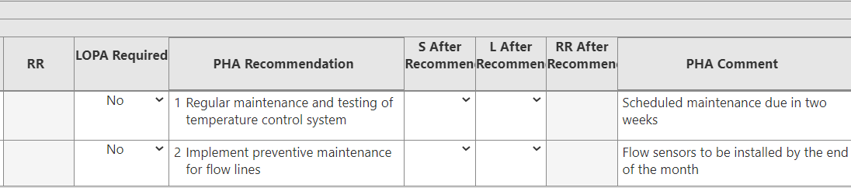
PHA Worksheets

Slide 6
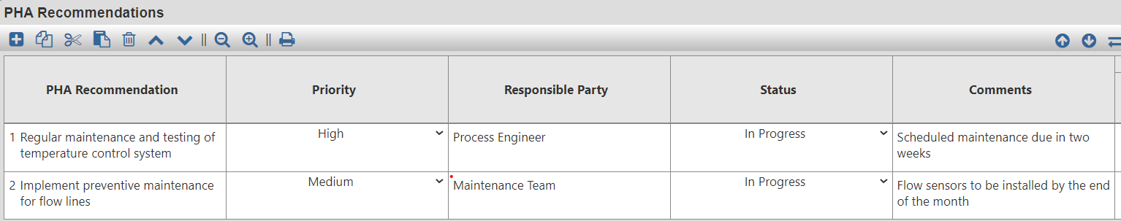
Recommendation

Slide 7
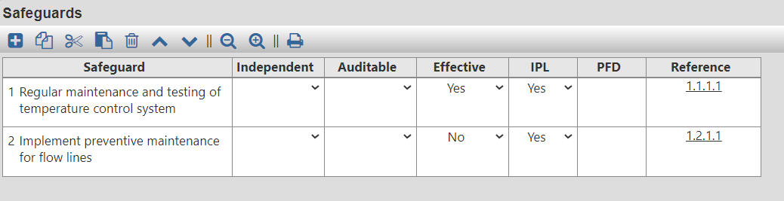
Safegaurds

Slide 8
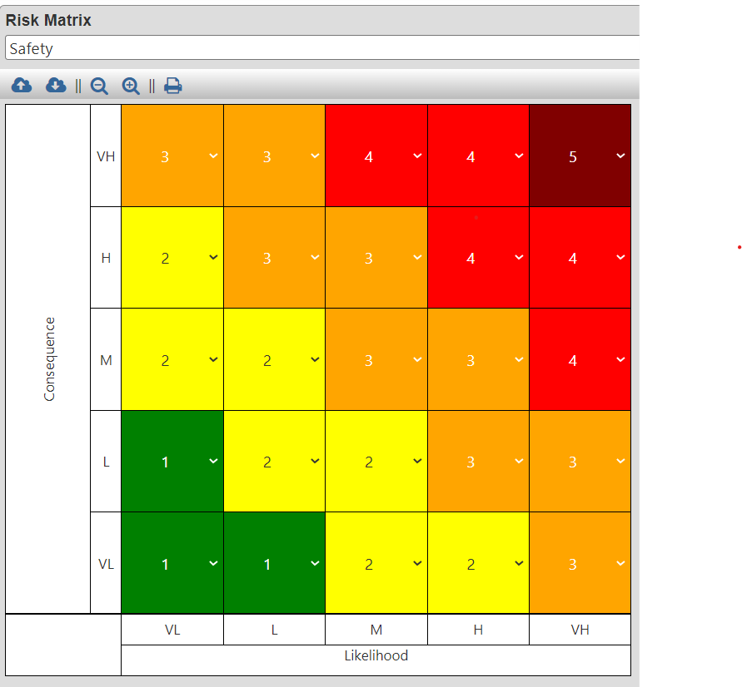
Risk Matrix

Slide 9
Code
Step 1: Define the process
In this step, you define the system or process that will be analyzed in the HAZOP study.
import pandas as pd
import numpy as np
# Hypothetical deviations with risk criteria
deviations_data = {
'Node': ['Reactor R-101', 'Reactor R-101'],
'Deviation': ['High temperature', 'Low flow rate'],
'Guide Word': ['High', 'Low'],
'Parameter': ['Temperature', 'Flow Rate'],
'Design Intent': ['React chemicals A and B to form compound X', 'React chemicals A and B to form compound X'],
'Cause': ['Failure of temperature control system', 'Blockage in the flow line'],
'Consequence': ['Thermal runaway, potential for reactor overpressure',

Slide 10
'Incomplete reaction, decreased product yield'],
'Consequence Category': ['Fire/Explosion', 'Quality/Productivity'],
'IPL Requirement': ['Temperature sensor with alarm and automatic shutdown', 'Flow rate monitoring system with interlock'],
'LOPA Requirement': ['Safety interlock and emergency shutdown system', 'Additional flow sensors for redundancy'],
'PHA Recommendation': ['Regular maintenance and testing of temperature control system', 'Implement preventive maintenance for flow lines'],

Slide 11
'Priority': ['High', 'Medium'],
'Responsible Party': ['Process Engineer', 'Maintenance Team'],
'Status': ['Open', 'Open'],
'Comments': ['Scheduled maintenance due in two weeks', 'Flow sensors to be installed by the end of the month'],
'Safeguard': ['Temperature emergency shutdown system', 'Flow rate alarms and interlocks'],
'Safeguard Effectiveness': ['Highly effective', 'Effective'],
'Risk Criteria': ['Tolerable if frequency < 1/year', 'Tolerable if production loss < 5%'],

Slide 12
Step 2: Create a DataFrame from the deviations data
# Create a DataFrame from the deviations data
deviations_df = pd.DataFrame(deviations_data)
# Risk levels mapping
risk_levels = {
'Low': 1,
'Medium': 3,
'High': 5,
}
# Map consequence severity and likelihood to risk levels
deviations_df['Consequence Severity Level'] = deviations_df['Consequence'].map(risk_levels)
deviations_df['Likelihood Level'] = deviations_df['Priority'].map(risk_levels)

Slide 13
Step 3: Risk Matrix
# Generate the risk matrix (original)
risk_matrix_data = {
'Consequence \ Likelihood': ['Insignificant', 'Minor', 'Moderate', 'Major', 'Severe'],
'Level 1': ['Green', 'Green', 'Green', 'Yellow', 'Yellow'],
'Level 2': ['Green', 'Green', 'Yellow', 'Yellow', 'Orange'],
'Level 3': ['Yellow', 'Yellow', 'Yellow', 'Orange', 'Orange'],
'Level 4': ['Yellow', 'Orange', 'Orange', 'Orange', 'Red'],
'Level 5': ['Orange', 'Orange', 'Red', 'Red', 'Brown'],

Slide 14
# Create a DataFrame for the risk matrix (original)
risk_matrix_df = pd.DataFrame(risk_matrix_data)
# Set the risk levels as index
risk_matrix_df.set_index('Consequence \ Likelihood', inplace=True)
# Add a row and column of zeros to the original risk matrix
zero_row = pd.Series([0] * len(risk_matrix_df.columns), name='Zero')
risk_matrix_df_with_zeros = pd.concat([zero_row, risk_matrix_df], axis=0)
risk_matrix_df_with_zeros = pd.concat([zero_row, risk_matrix_df_with_zeros], axis=1)

Slide 15
Generate the mirrored risk matrix
# Generate the mirrored risk matrix
upper_triangle = np.triu(risk_matrix_df_with_zeros.values)
mirrored_risk_matrix = np.concatenate((upper_triangle, upper_triangle.T), axis=1)

Slide 16
Create a DataFrame for the mirrored risk matrix
# Create a DataFrame for the mirrored risk matrix
columns = list(risk_matrix_df_with_zeros.columns)
index = list(risk_matrix_df_with_zeros.index) + list(risk_matrix_df_with_zeros.index)[1:][::-1]
mirrored_risk_matrix_df = pd.DataFrame(mirrored_risk_matrix, columns=columns, index=index)
# Save the DataFrames to Excel files
output_deviations_file = 'hazop_deviations_with_risk_matrix.xlsx'
output_risk_matrix_file = 'hazop_risk_matrix_mirrored.xlsx'
deviations_df.to_excel(output_deviations_file, index=False)
mirrored_risk_matrix_df.to_excel(output_risk_matrix_file)

Slide 17
Thank you

